Slide 1
Material: 44
Speed: 60
Travel: 24
Cooling: 11
Support: 73
Build Plate: 44
Dual Extrusion: 15
Mesh Fixes: 11
Special Modes: 14
Subtotal: 296
Experimental: 107
Total: 403

Slide 2
Organization Changes
This section contains some specific examples of suggested changes.
Notes:
The problem we are trying to solve.

Slide 3
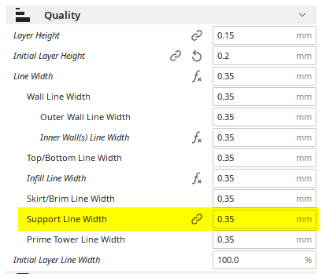
Support Line Width
Support Line Width is the only one of these settings that is “linked” and that is an indication something is wrong.
In this case, the setting is organized in the right place, but its behavior is wrong.
Line widths are more closely associated with nozzle size (extruder).
Each extruder needs its own Support Line Width.

Slide 4
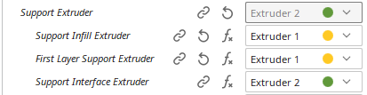
Support Line Width
1
OR
Imagine the case where there is one 0.4 mm nozzle and one 0.8 mm nozzle size loaded.
You have to first select which nozzle is used for support, then go back and set the support line width. This is awkward and unnecessary.
How is case of support interface versus support infill handled? One of the nozzles is going to be printing with the wrong Support Line Width for its size.
2

